Slide 1

Telecom Churn Rate
By: Heather McLauren

Slide 2

Questions to Explore on Churn Rate My goal in this project is to figure out what features are causing customer churn at a Telecom company and create a predictive model to help them in the future predict if a customer will cancel their account based on the important features I discovered in my model.
Question 1
How does the location of the clients affect churn?
Question 2
How does the international plan affect the churn rate?
Question 3
Is the International charges priced competitively by minutes enough to keep customers?

Slide 3
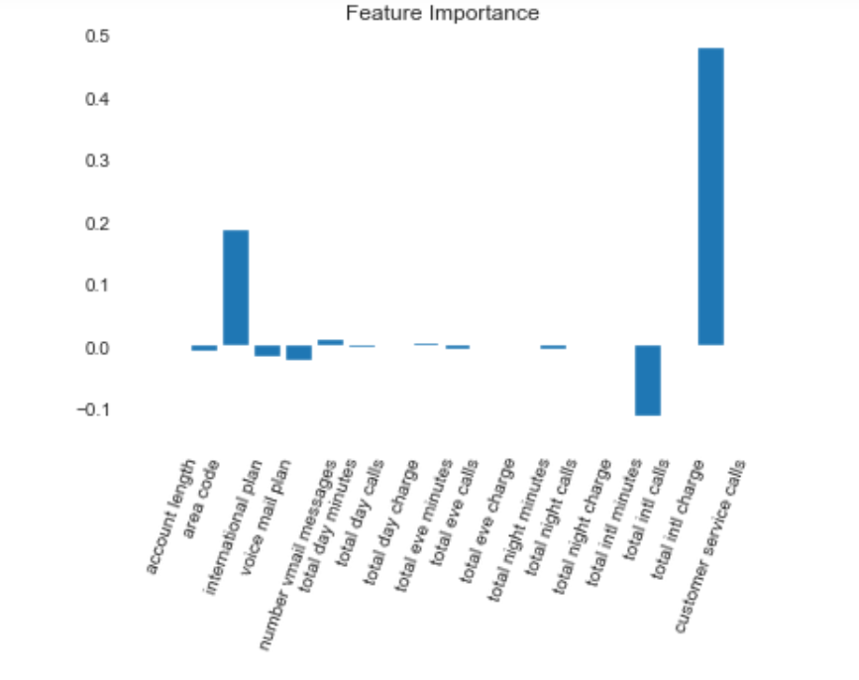
Important Features Discovered from Logistic Regression Modeling Accuracy score of: 85% Top Features to Explore Further: 1. Total International Charge 2. Area Code 3. Total International Minutes

Slide 4
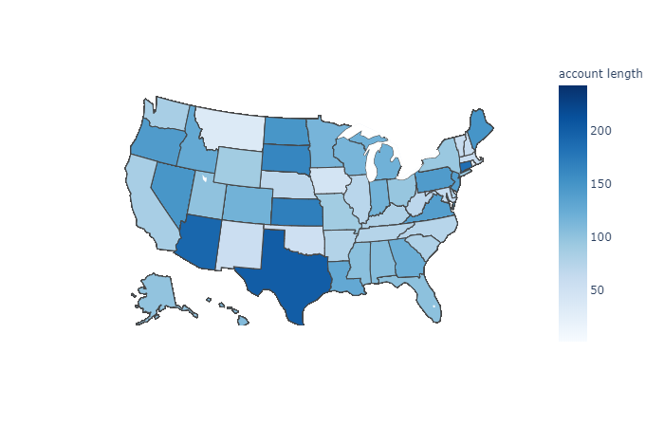
There are lower account lengths for states who are not typically known to be big business areas.
Question 1: How does the location of the clients affect churn?
States with the highest amount of customers
West Virginia -106
Minnesota - 84
New York - 83
Alabama - 80
Wisconsin - 78

Slide 5
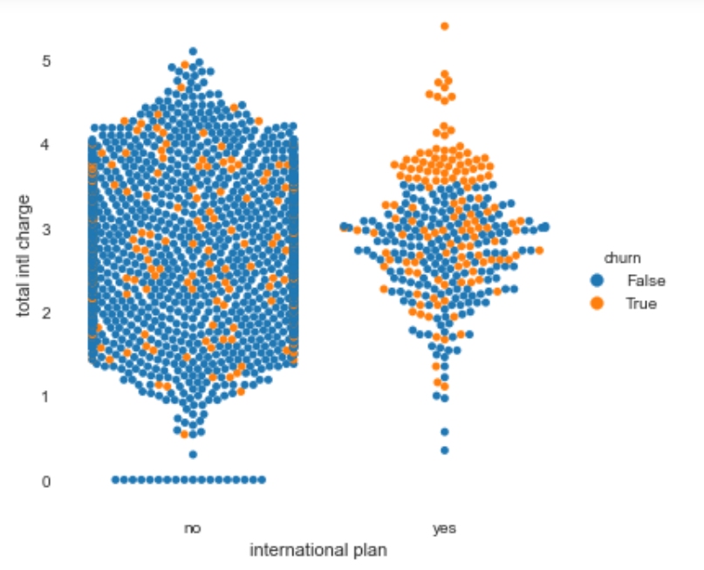
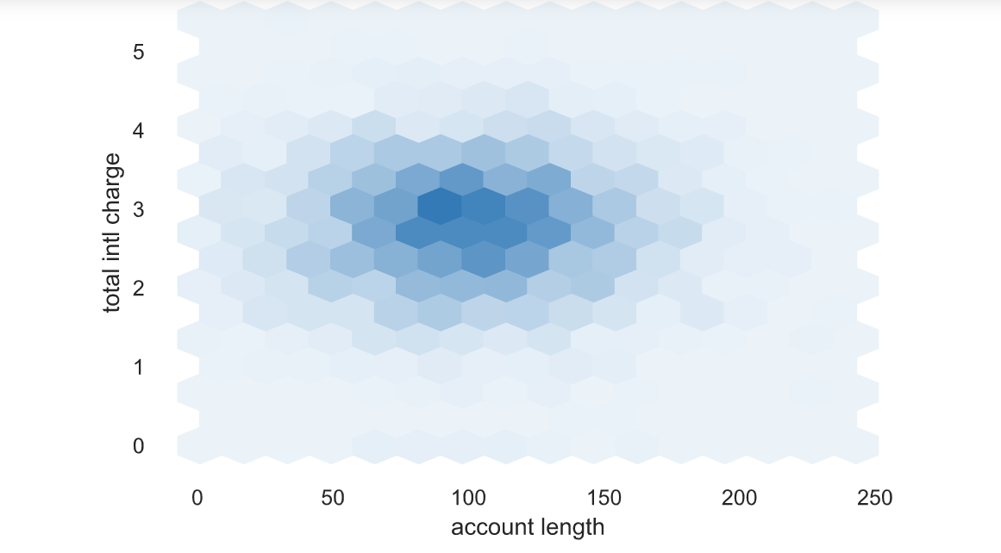
There are higher customer churn with customer with international plans when their total international charges are 3.5 and higher a month. There is a sweet spot for accounts staying active when the total international charges are between 2 and 3.5 a month.
Question 2: How does the international plan affect the churn rate?

Slide 6
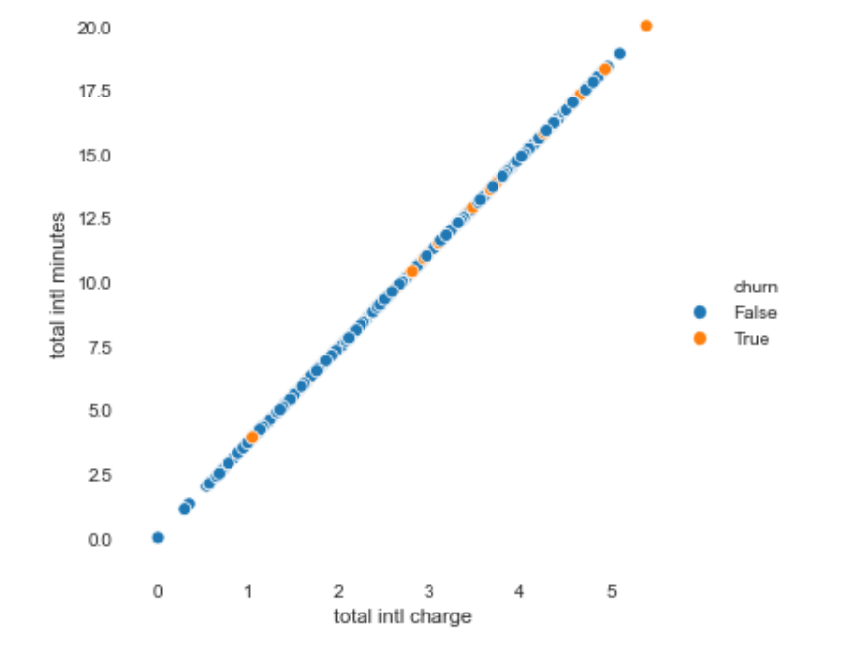
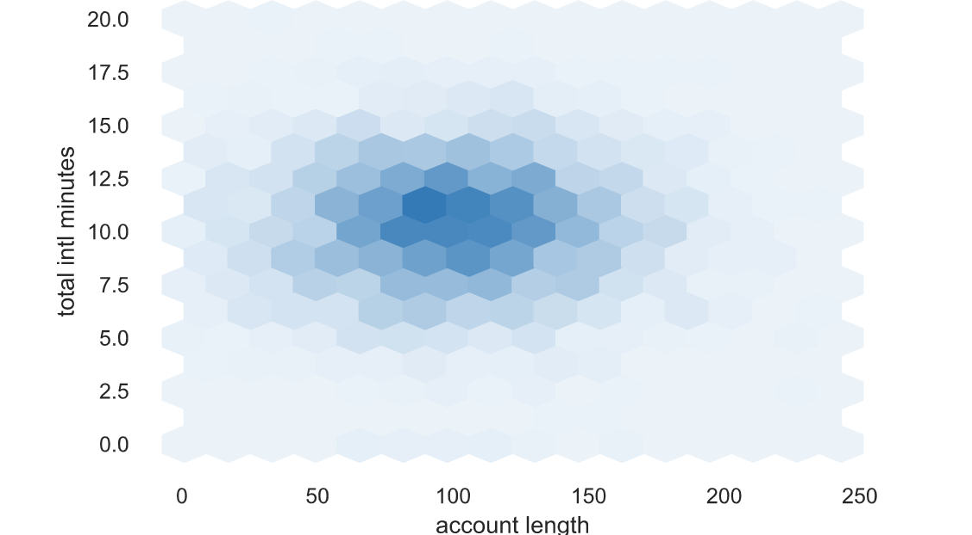
There are higher customer churn when the customer uses more than 10 minutes a month on the international plan. The average account length uses around 7.5 to 13 international minutes a month.
Question 3: Is the International charges priced competitively by minutes enough to keep customers?

Slide 7
Recommendations Based on my findings, I recommend the following:
Recommendation 1
Create a better International Plan for their customers
Recommendation 2
Optimize your pricing for a better value
Recommendation 3
Refocus on who your target market is to increase poor customer/product fit and watch out for competitors and conduct a SWOT analysis

Slide 8
Future Work
1
Look into promotions targeted at the wrong market
2
Competitor’s International Plan
3
Product and service customer offerings

Slide 9
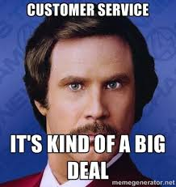
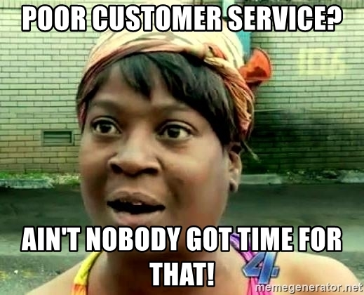
Thank you!

